Slide 1
GAN
2020/05/28 吳宗翰 陳延昊

Slide 2
Outline
Recap
SAGAN
BigGAN
SinGAN
GauGAN
GANILLA
NICE-GAN

Slide 3
Outline
Recap
SAGAN
BigGAN
SinGAN
GauGAN
GANILLA
NICE-GAN

Slide 4
GAN (2014)
ImprovedGAN (2016)
DCGAN (2015)
CycleGAN (2017)
PGGAN (2017)
WGAN (2017)
Video2video (2018)
WGAN-GP (2017)
SAGAN (2019)
StyleGAN (2019)
BigGAN (2019)
SNGAN (2018)
StackGAN (2017)
SeqGAN (2017)

Slide 5
GAN (2014)
Stabilize training
Use CNN
ImprovedGAN (2016)
DCGAN (2015)
Cycle-Consistency Loss
Wasserstein Distance
Progressively train
CycleGAN (2017)
PGGAN (2017)
WGAN (2017)
Video2video (2018)
Gradient penalty
Stacking layers
RL
WGAN-GP (2017)
SAGAN (2019)
StyleGAN (2019)
Solve it gracefully
SNGAN (2018)
BigGAN (2019)
StackGAN (2017)
SeqGAN (2017)
Notes:
強制gradient的l2 norm要=1

Slide 6
Outline
Recap
SAGAN
BigGAN
SinGAN
GauGAN
GANILLA
NICE-GAN

Slide 7
Self-attention GAN (SAGAN)
Self-attention
Spectral normalization (SN) for both G and D
Imbalanced learning rate for G and D (TTUR)
Zhang H, Goodfellow I, Metaxas D, Odena A. Self-attention generative adversarial networks. arXiv preprint arXiv:1805.08318. 2018 May 21.

Slide 8
Self-attention GAN (SAGAN)
Self-attention
Spectral normalization (SN) for both G and D
Imbalanced learning rate for G and D (TTUR)
Zhang H, Goodfellow I, Metaxas D, Odena A. Self-attention generative adversarial networks. arXiv preprint arXiv:1805.08318. 2018 May 21.

Slide 9
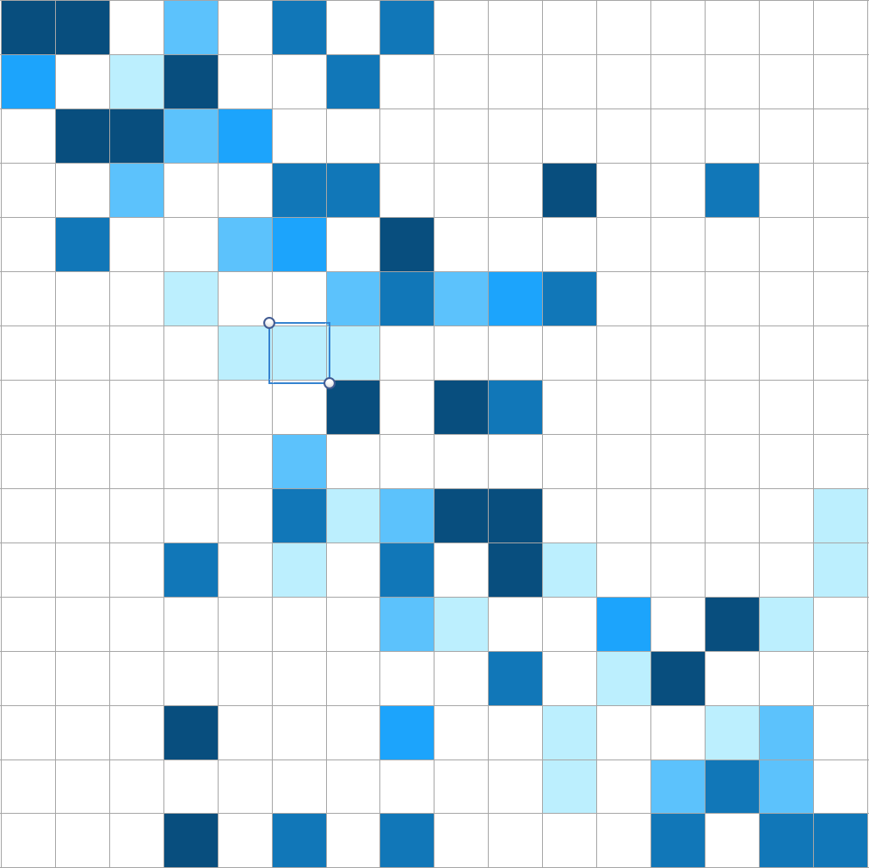
Self-attention
L × L
L × D
Transpose
Query
⊗
Softmax
Key
Input
⊗
Output
L × D
L × L
L × D
L × D
Value
⊗: Matrix Multiplication
L × D
Notes:
Long-range dependencies

Slide 10
Self-attention
L × L
L × D
Transpose
Query
⊗
Softmax
Key
1×1 CNN
Input
⊗
Output
L × D
L × L
L × D
L × D
1×1 CNN
Value
⊗: Matrix Multiplication
L × D
Notes:
Long-range dependencies

Slide 11
Self-attention GAN (SAGAN)
Self-attention
Spectral normalization (SN) for both G and D
Imbalanced learning rate for G and D (TTUR)
Zhang H, Goodfellow I, Metaxas D, Odena A. Self-attention generative adversarial networks. arXiv preprint arXiv:1805.08318. 2018 May 21.

Slide 12
Spectral normalization (SN)
In SNGAN, SN is only applied to D
Here, SN is for both G and D (empirically)

Slide 13
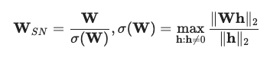
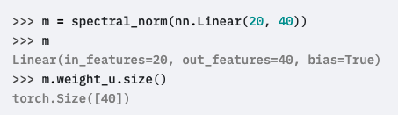
Spectral normalization (SN) in PyTorch
https://pytorch.org/docs/master/generated/torch.nn.utils.spectral_norm.html
Notes:
Power iteration

Slide 14
Self-attention GAN (SAGAN)
Self-attention
Spectral normalization (SN) for both G and D
Imbalanced learning rate for G and D (TTUR)
Zhang H, Goodfellow I, Metaxas D, Odena A. Self-attention generative adversarial networks. arXiv preprint arXiv:1805.08318. 2018 May 21.

Slide 15
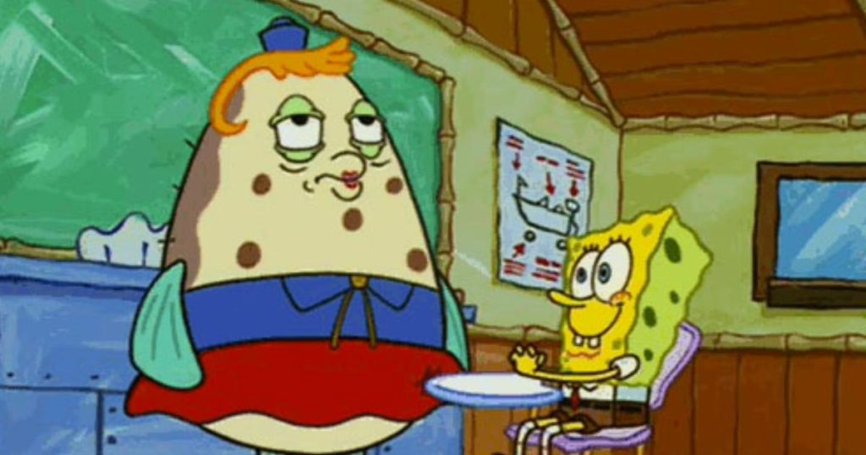
Two-Timescale Update Rule (TTUR)
Separate learning rates for G and D
lr for D: 0.0004
lr for G: 0.0001
Heusel, M., Ramsauer, H., Unterthiner, T., Nessler, B., and Hochreiter, S. GANs trained by a two time-scale update rule converge to a local nash equilibrium. In NIPS, pp. 6629–6640, 2017.
https://d2rd7etdn93tqb.cloudfront.net/wp-content/uploads/2018/04/mrs-puff-spongebob-frustrated-social-041318-1024x538.jpg
Notes:
在實作上，用regularized D會需要更多update次數(e.g. 5)

Slide 16
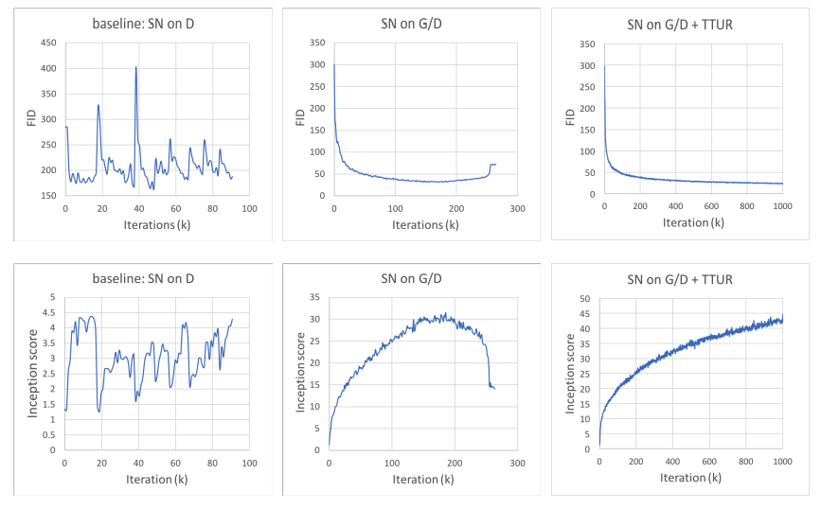
Results
Notes:
IS: inception v3 training data（image net），凡是跟這個不像的，分數就會較低
FID:用圖片的抽取出來的features來計算，可以某方面彌補inception scores的不足（IS沒有跟真實的dataset比較）
-> IS是把output跟image net比較，而FID則是把output跟training data比較

Slide 17
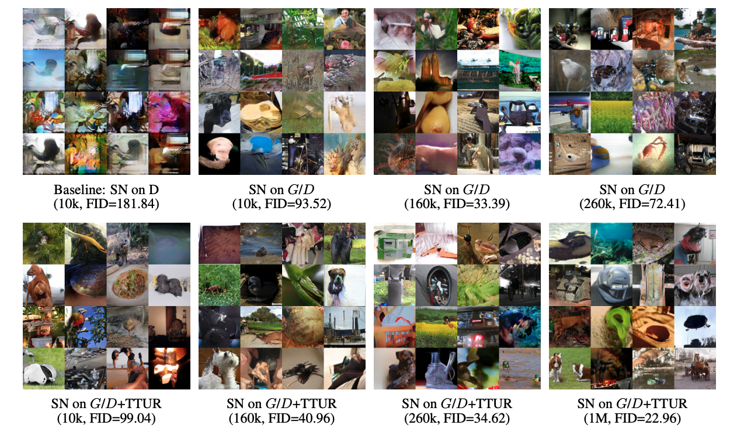
Ablation Study
Notes:
這裡的數字是iteration

Slide 18
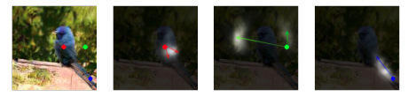
Visualization of attention maps
Notes:
這裡的attention會考慮texture跟color 而不單只是adjacency

Slide 19
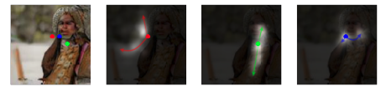
Visualization of attention maps
Notes:
即便在空間上很近，他也可能會有不同的attention pair

Slide 20
Outline
Recap
SAGAN
BigGAN
SinGAN
GauGAN
GANILLA
NICE-GAN

Slide 21
BigGAN
Based on SAGAN and SN
Two to four times as many parameters
Batch size * 8
Truncation Trick
Some insights about training stability
Brock A, Donahue J, Simonyan K. Large scale gan training for high fidelity natural image synthesis. arXiv preprint arXiv:1809.11096. 2018 Sep 28.

Slide 22
BigGAN
Based on SAGAN and SN
Two to four times as many parameters
Batch size * 8
Truncation Trick
Some insights about training stability
Brock A, Donahue J, Simonyan K. Large scale gan training for high fidelity natural image synthesis. arXiv preprint arXiv:1809.11096. 2018 Sep 28.
Notes:
要有十種模糊的小狗圖片，或是三張精緻的

Slide 23
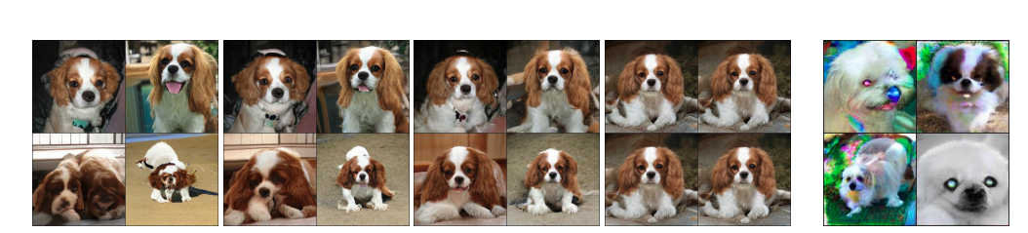
Truncation trick
2
1
0.5
0.04
Noise z ~ N (0,1)
Notes:
超過threshold時重新sample
可以看到threshold調小時，圖片都只有微調，如此一來雖然會降低diversity，但是可以finetune model在某些特定圖片上面，就可以產出品質較好的圖片
並不是所有的GAN都能使用這個技巧，有些model這樣做會壞掉。要避免這種情況就要用orthogonal regularization (gradient vanishing，需要W與input相互orthgonal)

Slide 24
BigGAN
Based on SAGAN and SN
Two to four times as many parameters
Batch size * 8
Truncation Trick
Some insights about training stability
Brock A, Donahue J, Simonyan K. Large scale gan training for high fidelity natural image synthesis. arXiv preprint arXiv:1809.11096. 2018 Sep 28.

Slide 25
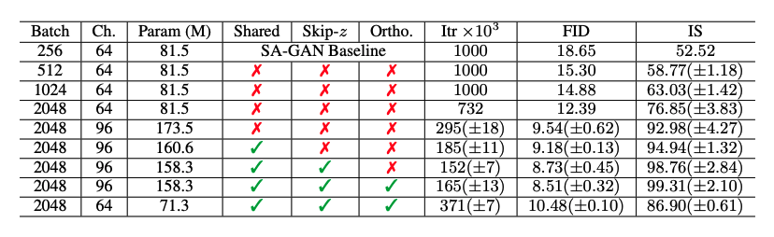
Some insights
Notes:
加深是沒有用的，作者就沒有放上來了
Iter不到1000就表示model壞掉了，需要early stopping (model愈大訓練得愈快 但是也會愈早壞掉)

Slide 26
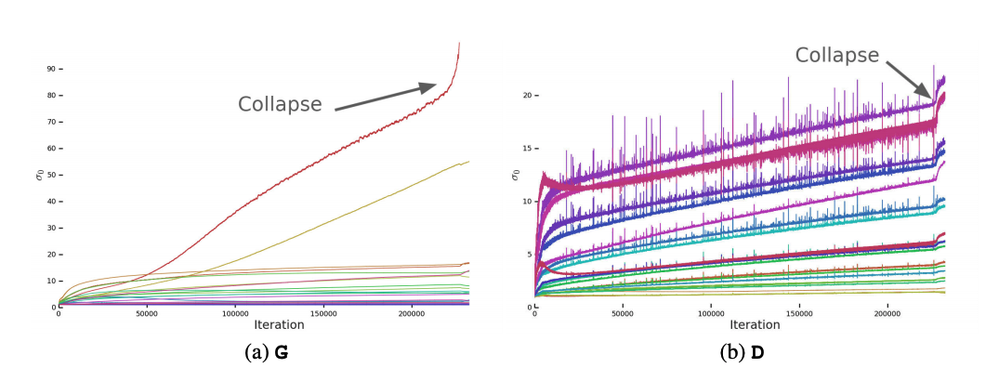
Some insights
Notes:
儘管前面都很穩定，還是有可能訓練到一半就炸開
紅色到紫色代表深度加深
Y軸是singular value大小，不確定是哪一個channel

Slide 27
Outline
Recap
SAGAN
BigGAN
SinGAN
GauGAN
GANILLA
NICE-GAN

Slide 28
SinGAN
One training data is enough!
Progressively train
Many application fields
Shaham TR, Dekel T, Michaeli T. Singan: Learning a generative model from a single natural image. InProceedings of the IEEE International Conference on Computer Vision 209 (pp. 4570-4580).

Slide 29
SinGAN
One training data is enough!
Progressively train
Many application fields
Shaham TR, Dekel T, Michaeli T. Singan: Learning a generative model from a single natural image. InProceedings of the IEEE International Conference on Computer Vision 209 (pp. 4570-4580).

Slide 30
One training example
https://scontent-tpe1-1.xx.fbcdn.net/v/t1.0-9/98053952_10163743532515296_6125130531014180864_n.jpg?_nc_cat=1&_nc_sid=110474&_nc_ohc=AP1k-nOxv2QAX_24Min&_nc_ht=scontent-tpe1-1.xx&oh=7129f16449e0a1dd5b04ab55fe051485&oe=5EEE2B80

Slide 31
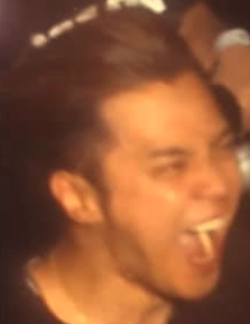
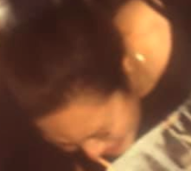
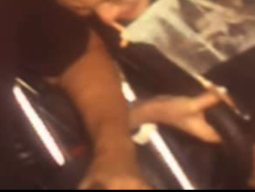
One training example

Slide 32
Trade-off
For a 200*200 image:
150*150: ~2500
But MNIST (28*28) datatset: ~55000
Notes:
可以先切出大圖像來訓練，雖然會很模糊，卻保留了整體訊息
接下來再用小的找片來捕捉細節

Slide 33
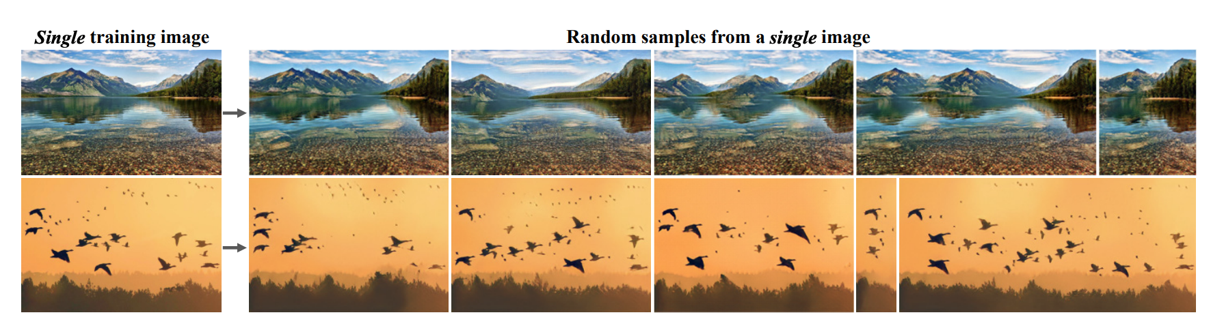
One training example

Slide 34
SinGAN
One training data is enough!
Progressively train
Many application fields
Shaham TR, Dekel T, Michaeli T. Singan: Learning a generative model from a single natural image. InProceedings of the IEEE International Conference on Computer Vision 209 (pp. 4570-4580).

Slide 35
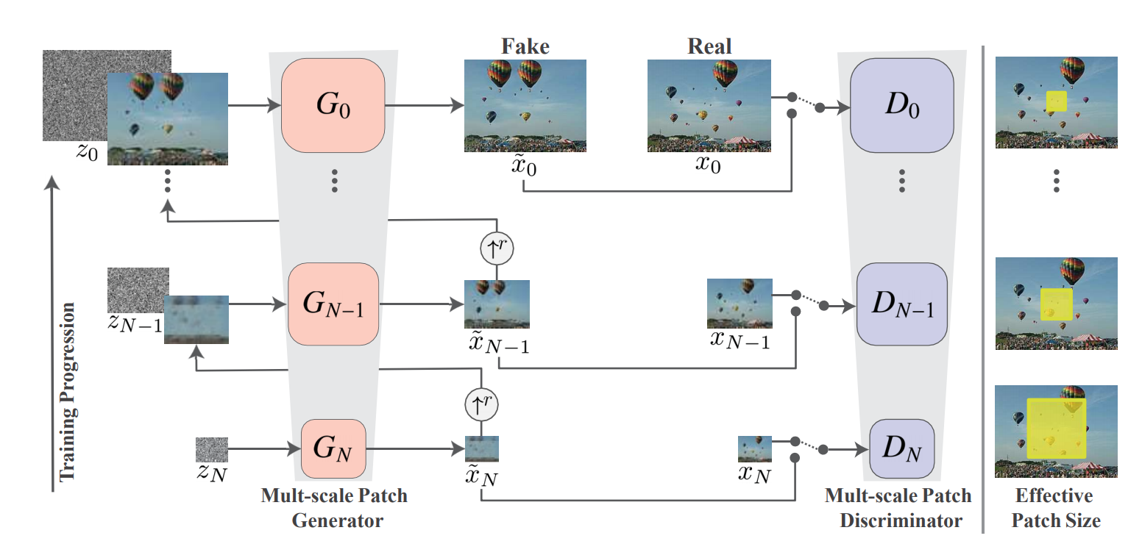
Progressively train

Slide 36
Progressively train
Notes:
最下層是最粗糙，SinGAN由很多個GAN組成

Slide 37
Progressively train
Notes:
每層都sample一個noise

Slide 38
Progressively train
Notes:
upsample

Slide 39
Progressively train
Notes:
downsample

Slide 40
Progressively train
11*11
Notes:
這邊可以看成很多張11*11的小圖片被輸入

Slide 41
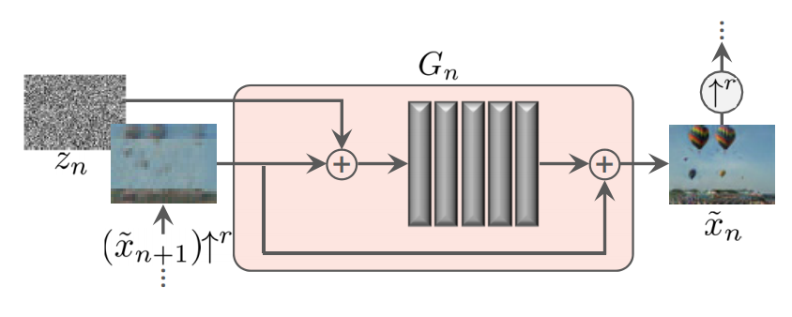
Progressively train
Conv.

Slide 42
SinGAN
One training data is enough!
Progressively train
Many application fields
Shaham TR, Dekel T, Michaeli T. Singan: Learning a generative model from a single natural image. InProceedings of the IEEE International Conference on Computer Vision 209 (pp. 4570-4580).

Slide 43
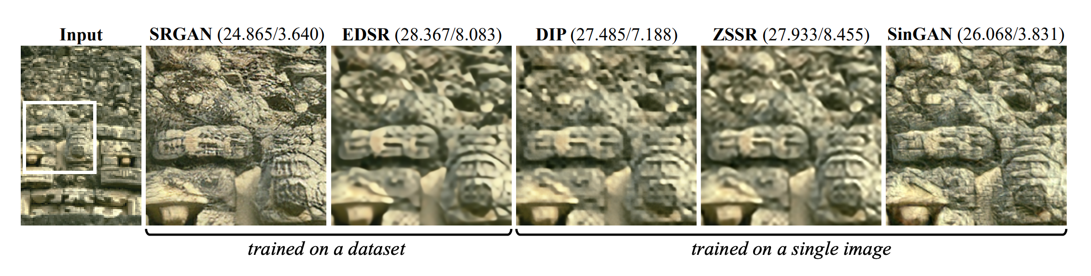
Super Resolution

Slide 44
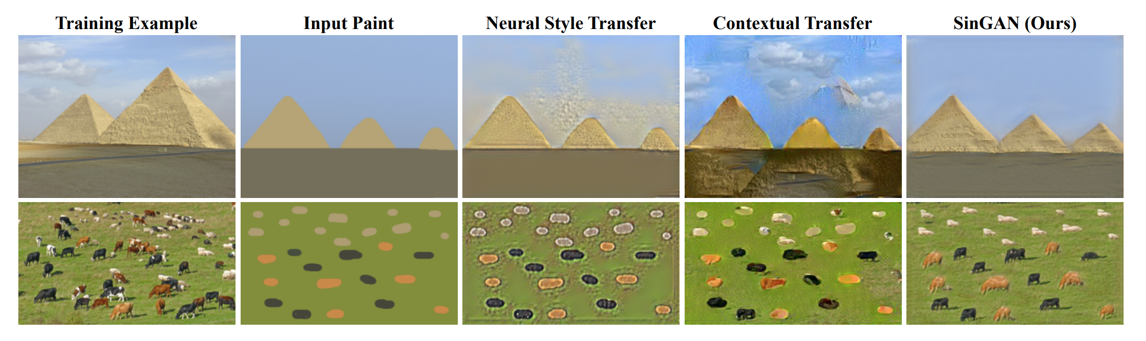
Paint to image

Slide 45
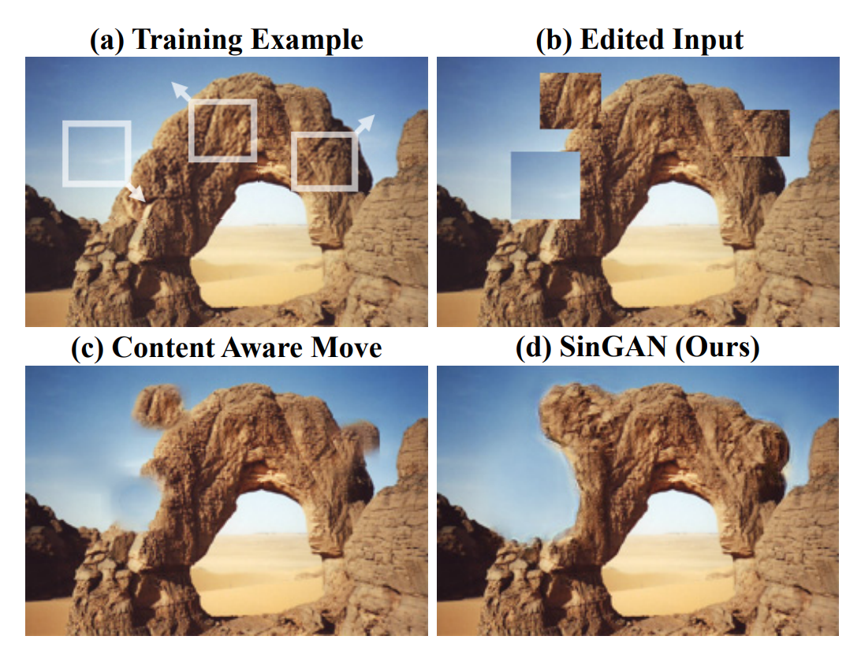
Image editing

Slide 46
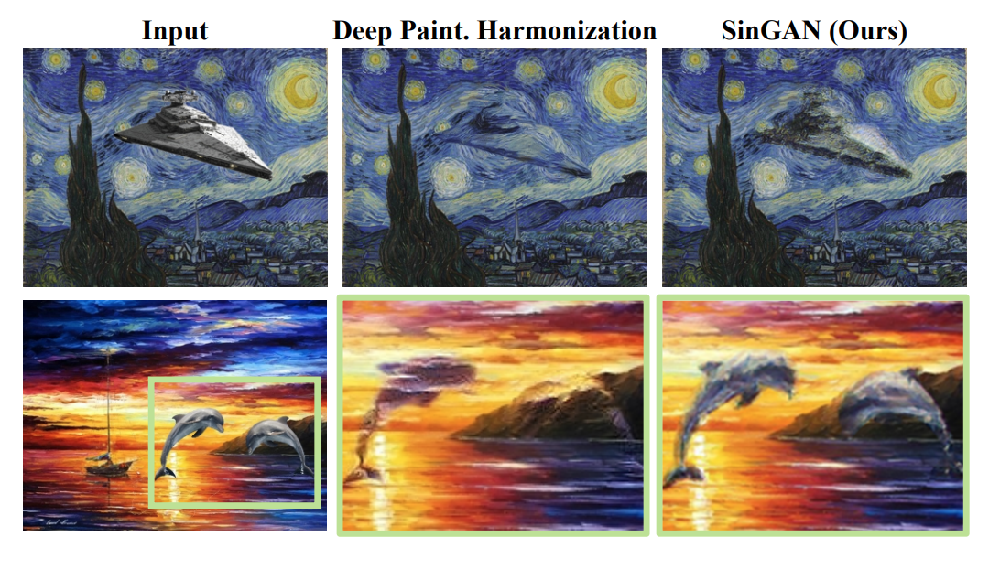
Image harmonization

Slide 47
Outline
Recap
SAGAN
BigGAN
SinGAN
GauGAN
GANILLA
NICE-GAN

Slide 48
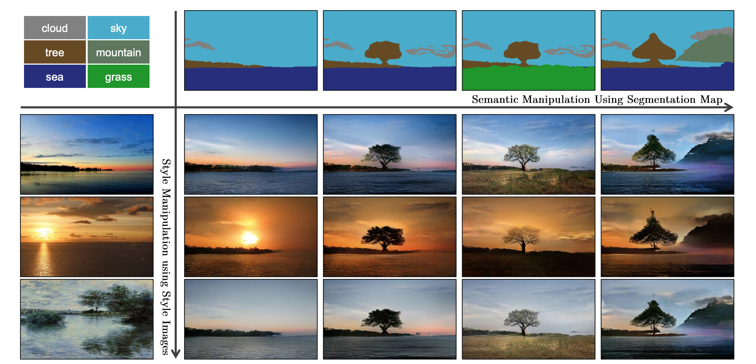
GauGAN
Park T, Liu MY, Wang TC, Zhu JY. Semantic image synthesis with spatially-adaptive normalization. InProceedings of the IEEE Conference on Computer Vision and Pattern Recognition 2019 (pp. 2337-2346).

Slide 49
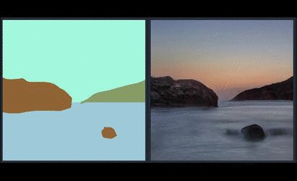
GauGAN
SPADE
Use encoder (Style)
Park T, Liu MY, Wang TC, Zhu JY. Semantic image synthesis with spatially-adaptive normalization. InProceedings of the IEEE Conference on Computer Vision and Pattern Recognition 2019 (pp. 2337-2346).
Notes:
一種norm (input dependent)

Slide 50
GauGAN
SPADE
Use encoder (Style)
Park T, Liu MY, Wang TC, Zhu JY. Semantic image synthesis with spatially-adaptive normalization. InProceedings of the IEEE Conference on Computer Vision and Pattern Recognition 2019 (pp. 2337-2346).
Notes:
一種norm (input dependent)

Slide 51
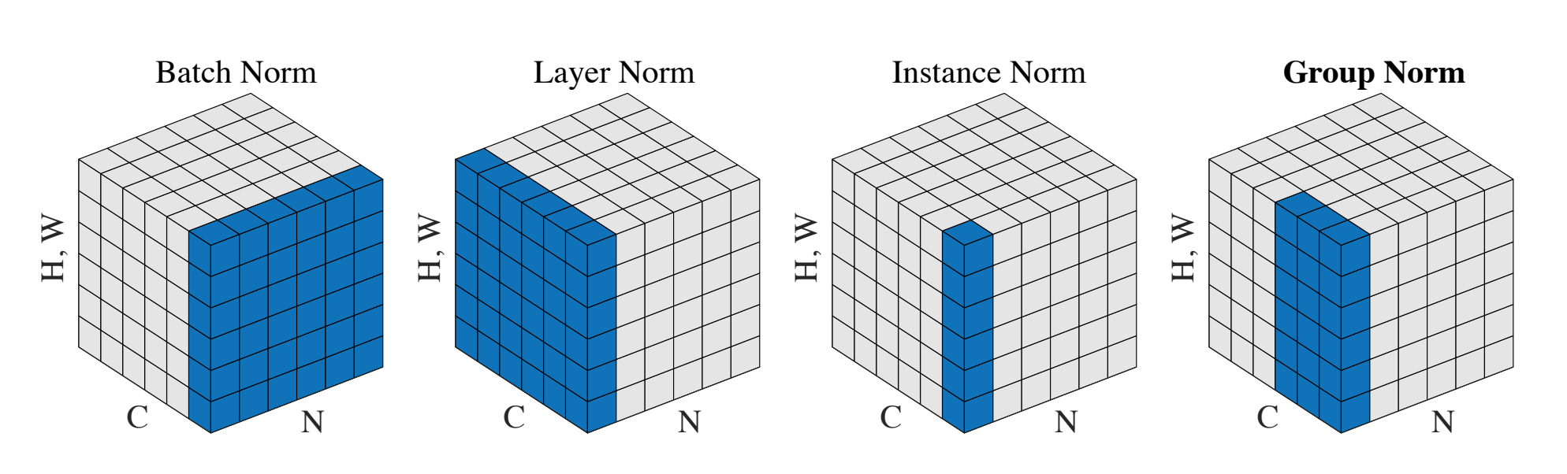
Unconditional Normalization
Wu Y, He K. Group normalization. InProceedings of the European Conference on Computer Vision (ECCV) 2018 (pp. 3-19).

Slide 52
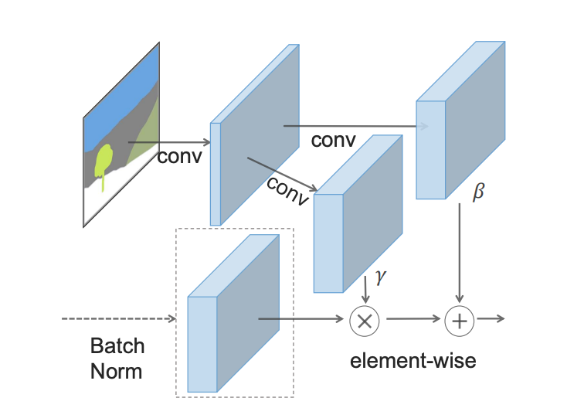
Conditional Normalization (SPADE)

Slide 53
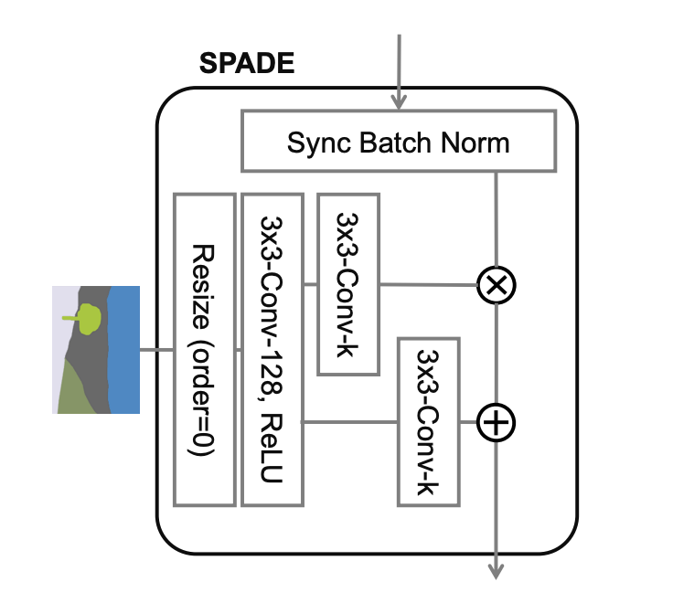
Conditional Normalization (SPADE)

Slide 54
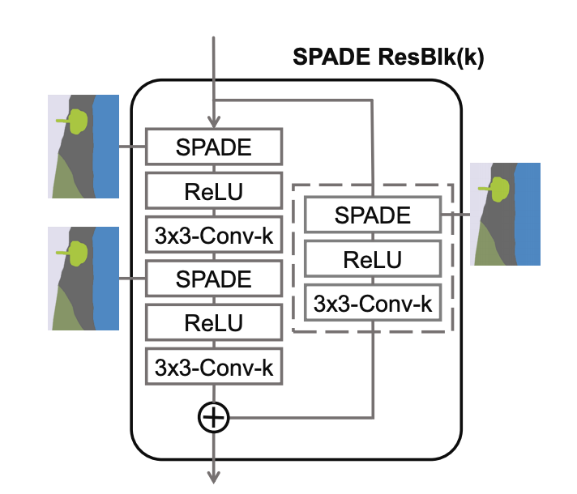
SPADE ResBlk

Slide 55
GauGAN
SPADE
Use encoder (Style)
Park T, Liu MY, Wang TC, Zhu JY. Semantic image synthesis with spatially-adaptive normalization. InProceedings of the IEEE Conference on Computer Vision and Pattern Recognition 2019 (pp. 2337-2346).

Slide 56
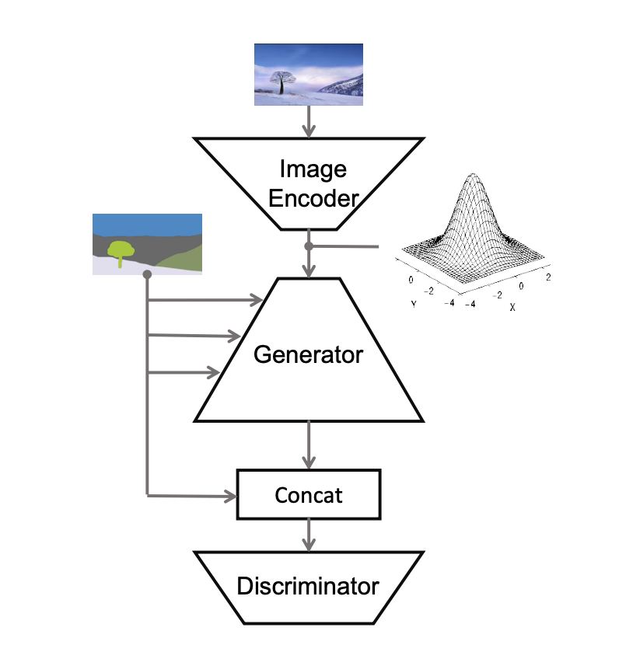
Overall
VAE-GAN
Notes:
分三個部分
老師影片連結

Slide 57
GauGAN
Park T, Liu MY, Wang TC, Zhu JY. Semantic image synthesis with spatially-adaptive normalization. InProceedings of the IEEE Conference on Computer Vision and Pattern Recognition 2019 (pp. 2337-2346).

Slide 58
Overall
VAE-GAN

Slide 59
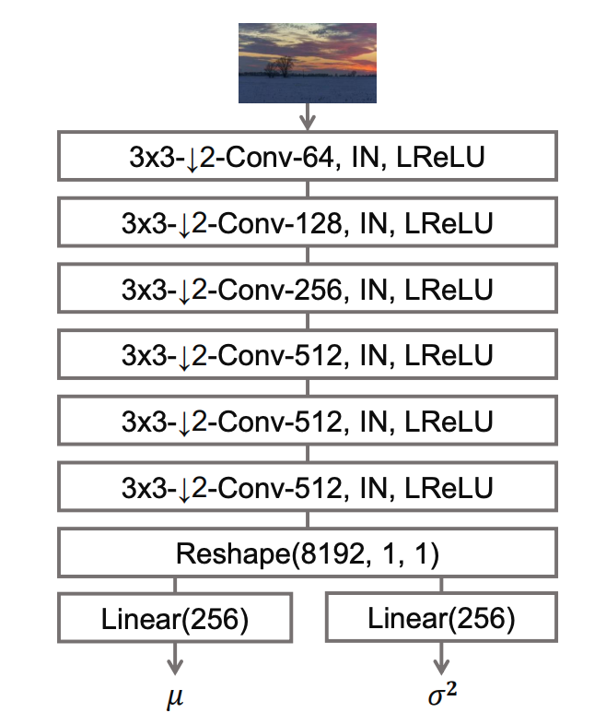
Encoder
Notes:
這兩個變數用來產生noise input to the G

Slide 60
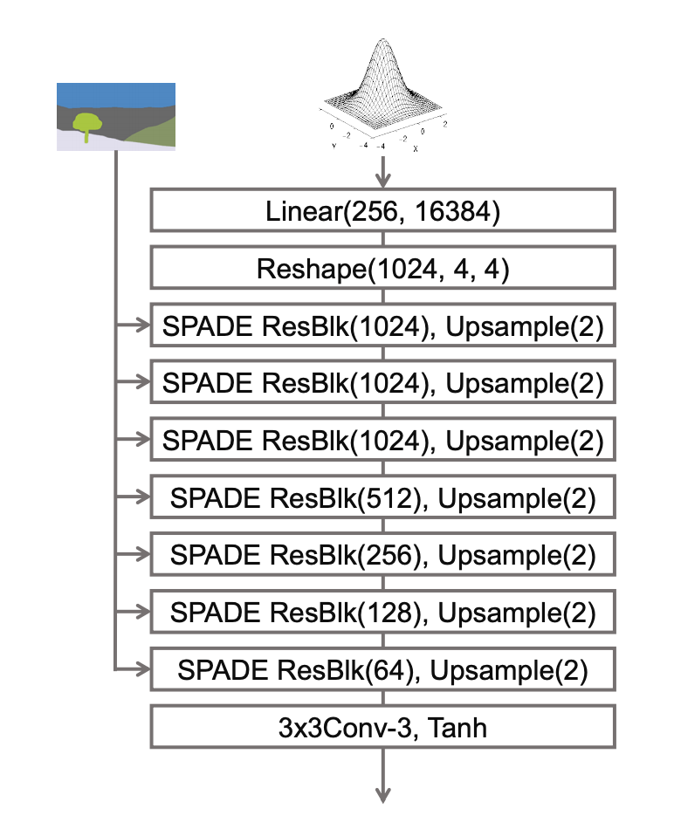
G
Notes:
分三個部分

Slide 61
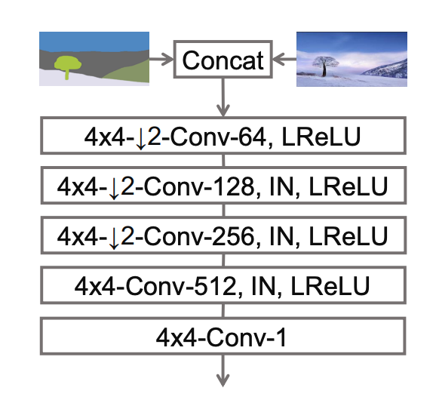
D
Notes:
分三個部分

Slide 62
Outline
Recap
SAGAN
BigGAN
SinGAN
GauGAN
GANILLA
NICE-GAN

Slide 63
GANILLA
Unpaired data
Either Style or Content (e.g. CycleGAN, DualGAN, CartoonGAN)
Propose an extensive children’s books illustration dataset
Hicsonmez S, Samet N, Akbas E, Duygulu P. GANILLA: Generative adversarial networks for image to illustration translation. Image and Vision Computing. 2020 Mar 1;95:103886.
Notes:
這裡使用unpaired data，我們需要的是兩個不同領域的corpus。這邊的source domain是自然風景照片，target domain則是插圖
童書裡面顏色對比通常都很鮮明，而這對model來說要同時遷移style&contect就成了一件頗困難的事

Slide 64
GANILLA
Unpaired data
Either Style or Content (e.g. CycleGAN, DualGAN, CartoonGAN)
Propose an extensive children’s books illustration dataset
Hicsonmez S, Samet N, Akbas E, Duygulu P. GANILLA: Generative adversarial networks for image to illustration translation. Image and Vision Computing. 2020 Mar 1;95:103886.
Notes:
現有的方法很難在風格以及轉換內容之間找到平衡

Slide 65
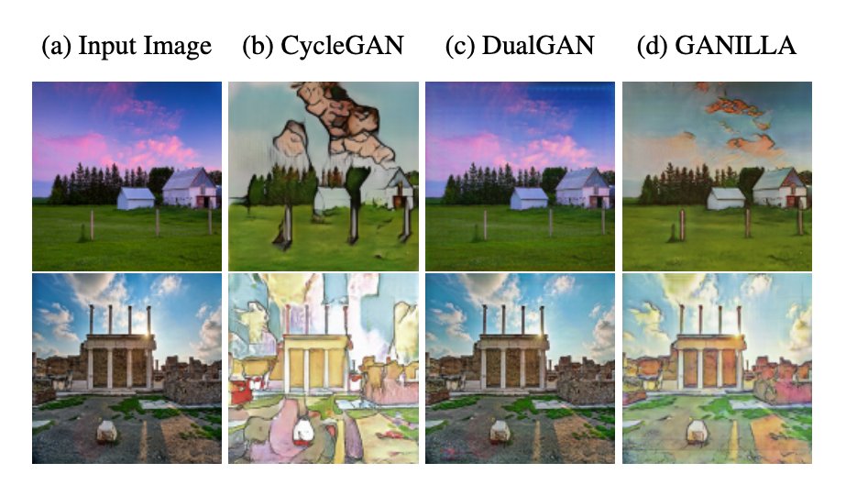
CycleGAN, DualGAN, and CartoonGAN
Unsupervised conditional generation
CycleGAN & DualGAN
CycleGAN in Voice Conversion
Notes:
老師之前上課有提過，其實他們還是有一點點不同
CycleGAN可以轉換風格，但是內容轉不太好
DualGAN則是相反

Slide 66

Comparison of G
Notes:
這裡是G

Slide 67
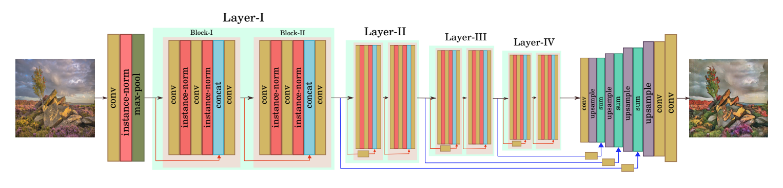
GANILLA
Morphological features: Edge, Shape.
Notes:
Low-level features

Slide 68

Comparison of G

Slide 69
GANILLA
Unpaired data
Either Style or Content (e.g. CycleGAN, DualGAN, CartoonGAN)
Propose an extensive children’s books illustration dataset
Hicsonmez S, Samet N, Akbas E, Duygulu P. GANILLA: Generative adversarial networks for image to illustration translation. Image and Vision Computing. 2020 Mar 1;95:103886.
Notes:
抽象程度高，色彩鮮豔

Slide 70
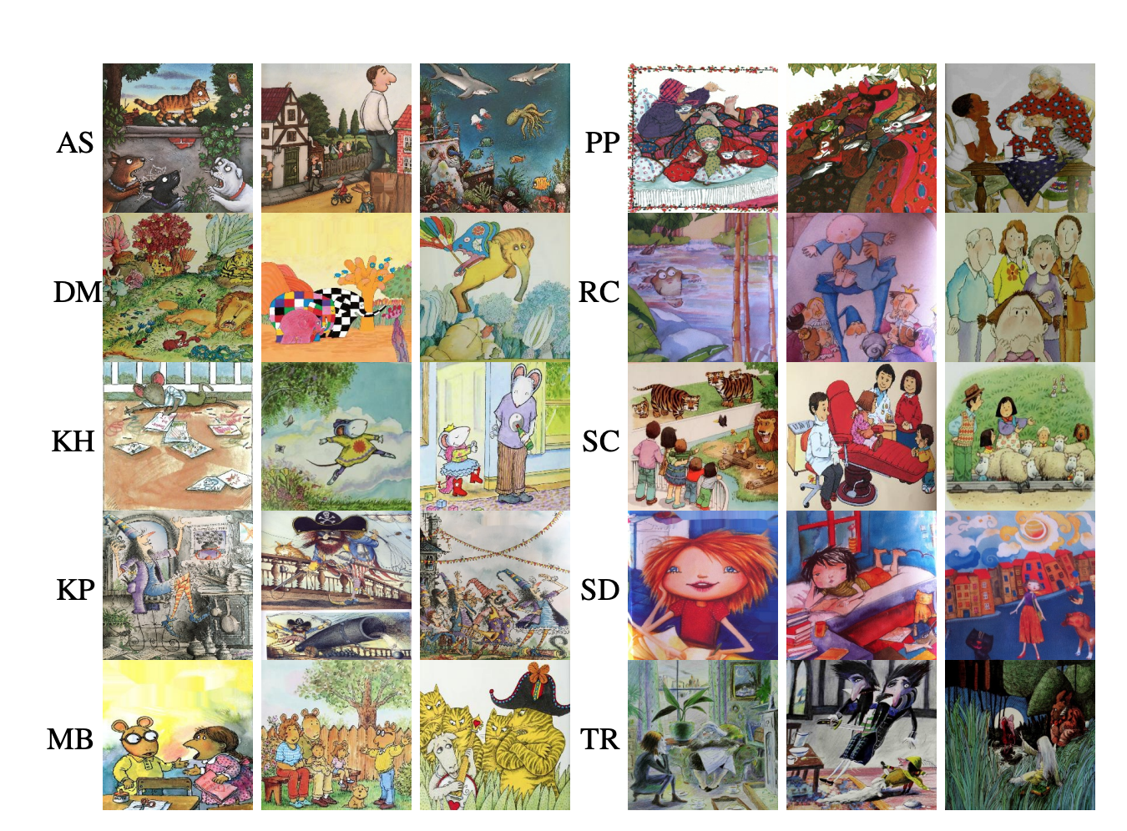
Dataset

Slide 71
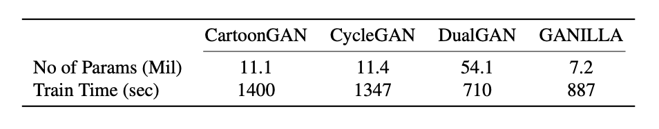
Result
Notes:
大部分情況都是GANILLA比較好，但有少數case DualGAN也很強大

Slide 72
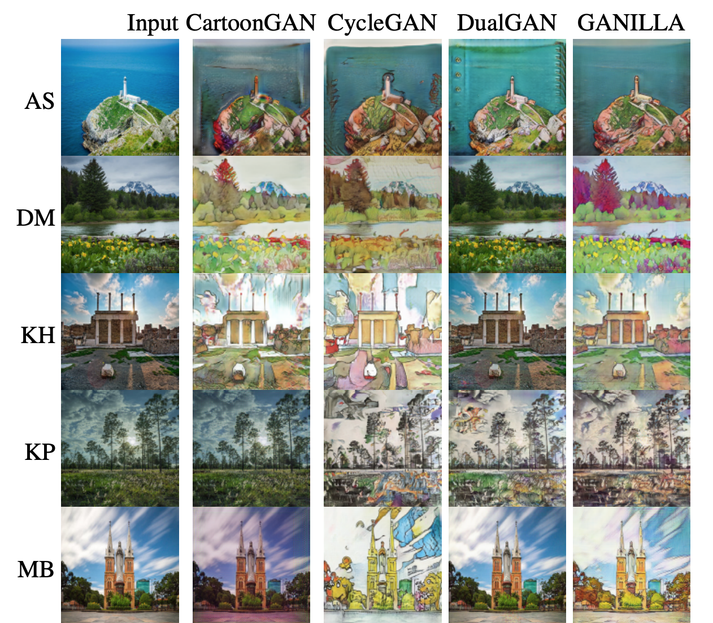
Result
Notes:
CycleGAN表現最差
citation:cycle>dual>cartoon

Slide 73

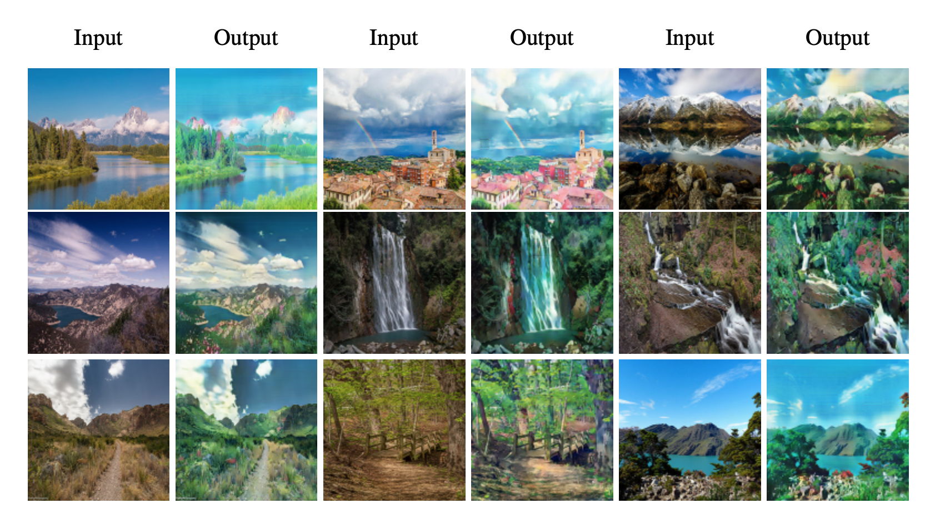
Hayao Style (宮崎駿)
Notes:
作者也收集了一些宮崎駿的插圖當作訓練資料，結果如本頁
這個model也有一些失敗的例子，如果input 圖像是木炭素描著色或單純的著色，則會產生品質較差的圖片

Slide 74
Outline
Recap
SAGAN
BigGAN
SinGAN
GauGAN
GANILLA
NICE-GAN

Slide 75
NICE-GAN
No independent encoder
Model structure
Chen R, Huang W, Huang B, Sun F, Fang B. Reusing Discriminators for Encoding Towards Unsupervised Image-to-Image Translation. arXiv preprint arXiv:2003.00273. 2020 Feb 29.

Slide 76
NICE-GAN
No independent encoder
Model structure
Chen R, Huang W, Huang B, Sun F, Fang B. Reusing Discriminators for Encoding Towards Unsupervised Image-to-Image Translation. arXiv preprint arXiv:2003.00273. 2020 Feb 29.

Slide 77
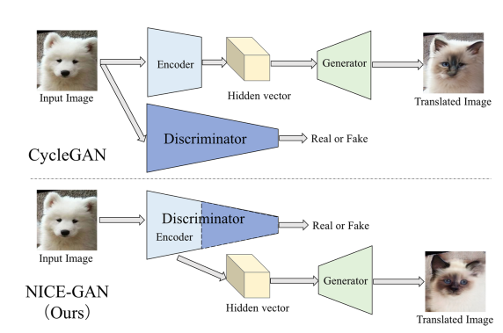
No independent encoder
Notes:
Encoder用來抽取hidden vector

Slide 78
Discriminator
Encoding
Classifying
Notes:
抽取特徵的能力
判斷

Slide 79
Advantages of sharing encoder and D
No need to train encoder independently
The encoder is trained more efficiently
Notes:
model更簡潔 不需要額外的運算量
原本encoder的更新靠的是從G接收到的gradient

Slide 80
Details of training D
Encoder: minimize loss
Discriminator: maximize loss
Notes:
Freeze encoder, only trainable when training D

Slide 81
NICE-GAN
No independent encoder
Model structure
Chen R, Huang W, Huang B, Sun F, Fang B. Reusing Discriminators for Encoding Towards Unsupervised Image-to-Image Translation. arXiv preprint arXiv:2003.00273. 2020 Feb 29.

Slide 82
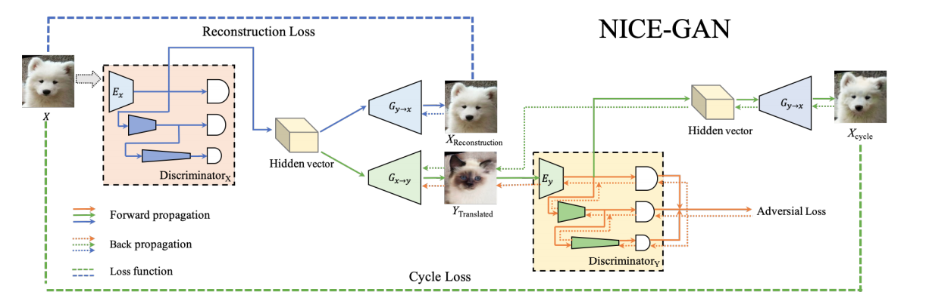
Model Structure
Notes:
CycleGAN的架構 以及loss
l_gan+l_recon+l_cyc

Slide 83
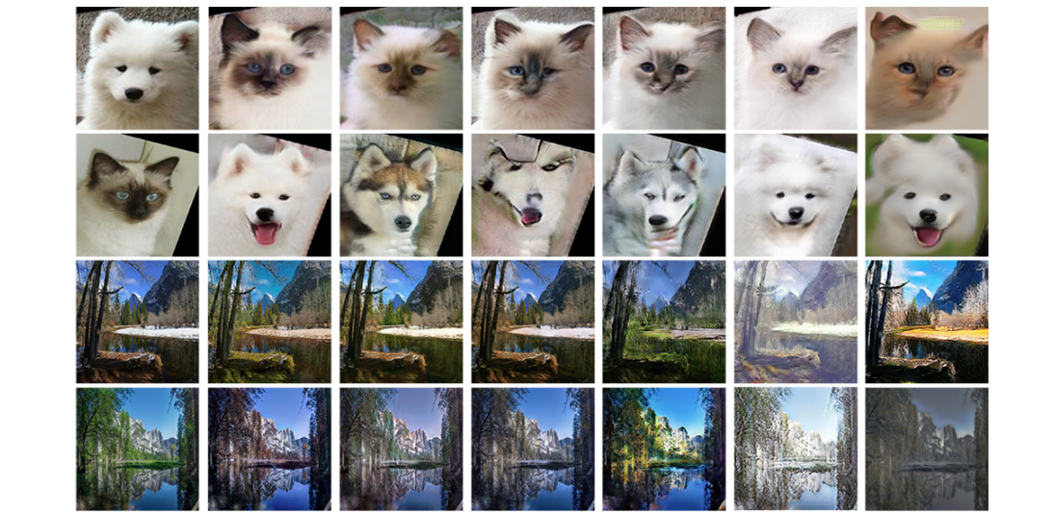
Result
Notes:
狗貓
冬夏

Slide 84
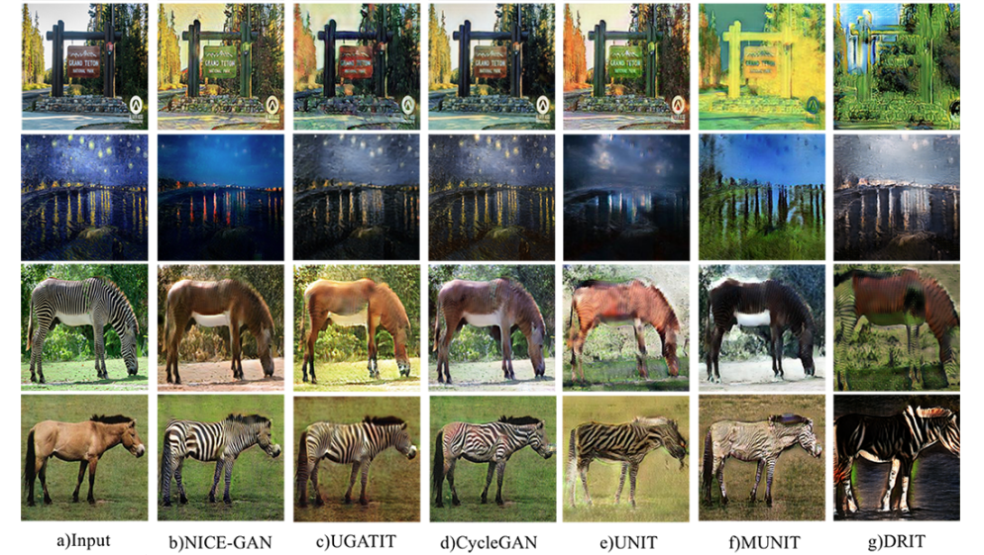
Result
Notes:
風景照梵谷
馬斑馬

Slide 85
Outline
Recap
SAGAN (Self-attention)
BigGAN (旗艦版 SAGAN)
SinGAN (將一張圖片切成很多小圖片當作訓練資料)
GauGAN (Conditional normalization)
GANILLA (CycleGAN/DualGAN mega進化、宮崎駿)
NICE-GAN (D的前半部當成encoder)

